Slide 1
THE FUNCTIONS OF MANAGEMENT

Slide 2
PLANNING
A formal process whereby managers choose goals, identify actions to attain those goals, allocate responsibility for implementing actions to specific individuals or units, measure the success of actions by comparing actual results against the goals, and revise plans accordingly.
(Sebuah proses formal dimana manajer memilih tujuan, mengidentifikasi tindakan-tindakan untuk mencapai tujuan tersebut, mengalokasikan tanggung jawab untuk melaksanakan tindakan untuk individu atau unit tertentu, mengukur keberhasilan tindakan dengan membandingkan hasil aktual terhadap tujuan, dan merevisi rencana.)

Slide 3
ORGANIZING
The process of deciding who within an organization will perform what tasks, where decisions will be made, who reports to whom, and how different parts of the organization will coordinate their activities to pursue a common goal.
(Proses memutuskan siapa dalam sebuah organisasi akan melakukan tugas apa, di mana keputusan akan dibuat, siapa melapor kepada siapa, dan bagaimana berbagai bagian organisasi akan mengkoordinasikan kegiatan mereka untuk mengejar tujuan bersama.)

Slide 4
LEADING
is the process of motivating, influencing, and directing others in the organization to work productively in pursuit of organization goals. (adalah proses memotivasi, mempengaruhi, dan mengarahkan orang lain dalam organisasi untuk bekerja secara produktif dalam mengejar tujuan organisasi)

Slide 5
CONTROLLING
is the process of monitoring performance against goals, intervening when goals are not met, and taking corrective action. (adalah proses pemantauan kinerja terhadap tujuan, intervensi ketika tujuan tidak terpenuhi, dan mengambil tindakan korektif.)

Slide 6
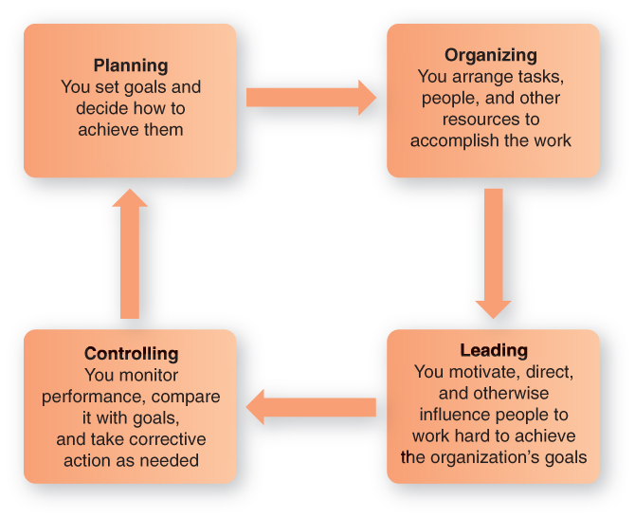
What Managers Do: The Four Principal Functions
Figure 1.1

Slide 7
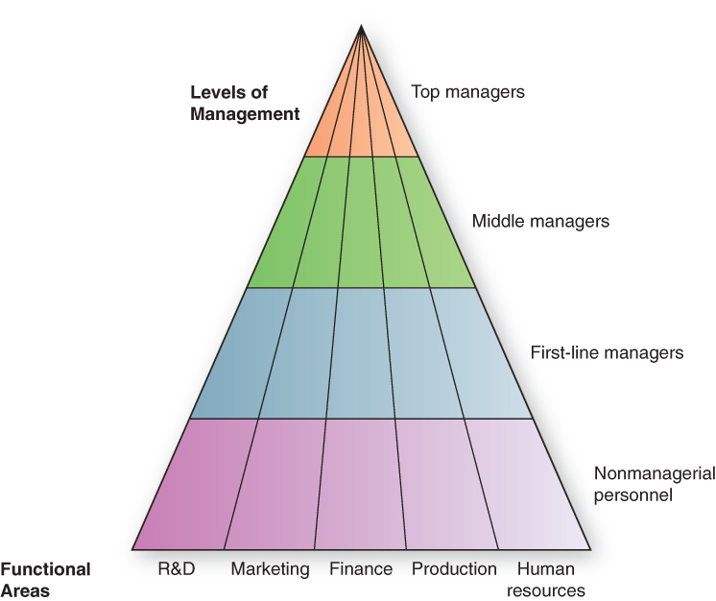
Pyramid Power: Levels & Areas of Management
Figure 1.2

Slide 8

Pyramid Power: Levels & Areas of Management
Top managers
make long-term decisions about the overall direction of the organization and establish the objectives, policies, and strategies for it

Slide 9
Pyramid Power: Levels & Areas of Management
Middle managers
implement the policies and plans of the top managers above them and supervise and coordinate the activities of the first-line managers below them
First-line managers
make short-term operating decisions, directing the daily tasks of nonmanagerial personnel

Slide 10
Pyramid Power: Levels & Areas of Management
Functional manager
responsible for just one organizational activity
General manager
responsible for several organizational activities

Slide 11
Three Types of Managerial Roles Mintzberg
Interpersonal roles
managers interact with people inside and outside their work units
figurehead, leader, liaison
Informational roles
managers receive and communicate information
monitor, disseminator, spokesperson

Slide 12
Three Types of Managerial Roles
Decisional roles
managers use information to make decisions to solve problems or take advantage of opportunities
entrepreneur, disturbance handler, resource allocator, negotiator

